Slide 1
NeuroDevelopmental disabilities and the transition from Pediatric to Adult Healthcare
Diana M. Cejas, M.D., M.P.H.
Assistant Professor of Neurology

Slide 2
Objectives
By the end of this presentation, you’ll be able to…
Describe the process of transitioning from pediatric to adult healthcare services
List the components of a transition plan
Start a conversation about transition to adult care
Notes:
I’m going to give an overview of healthcare transition. We’ll define and describe transition, talk about who is involved in the process, and spend a long time talking about making transition plans for our patients.

Slide 3
Transitioning to Adulthood
Moving from adolescence to adulthood affects every aspect of life
Home / Community
Educational System
Healthcare System
This is a process, not a single event!
Can be complicated for children with special healthcare needs
Notes:
Adolescence is an exciting time in a person’s life. They’re growing and developing physically, emotionally, and socially as well. Every aspect of their life is affected as a person transitions from adolescence to adulthood. That includes their relationship with the healthcare system. At some point, young people make the move from pediatric to adult healthcare providers. Unfortunately, this move can be confusing and uncertain at times, particularly for people with neurodevelopmental and intellectual disabilities. Though these individuals may have received some information about growing into adulthood, they often do not receive adequate information about what this means for their healthcare. That can cause significant problems for the individual, their families, and their healthcare providers.

Slide 4
What is Healthcare Transition?
“The planned movement of adolescents and young adults with chronic physical and medical conditions from a child-centered to an adult-oriented health care system”
Notes:
That brings us to healthcare transition.
This process is defined as the planned movement of adolescents and young adults with chronic physical and medical conditions from a child-centered to an adult-oriented health care system. Healthcare transition is a process, not a one time event. That process aims to get a patient and their family ready to move from pediatric to adult care, to empower them to advocate for their health, to help them understand how to use adult-focused health services, and to ensure that the entire process of moving from one provider to another goes as smoothly as possible for everyone involved.

Slide 5
Goals of Transition
To improve the ability of youth to manage their own health care and effectively use health services
To ensure an organized process to facilitate transition preparation, transfer of care, and integration into adult care
Notes:
That brings us to healthcare transition.
This process is defined as the planned movement of adolescents and young adults with chronic physical and medical conditions from a child-centered to an adult-oriented health care system. Healthcare transition is a process, not a one time event. That process aims to get a patient and their family ready to move from pediatric to adult care, to empower them to advocate for their health, to help them understand how to use adult-focused health services, and to ensure that the entire process of moving from one provider to another goes as smoothly as possible for everyone involved.

Slide 6
Why is This Important?
Children with complex conditions are living into adulthood
Inadequate, unplanned, or incomplete transition can → illness and gaps in care
Patients may not return until they are in crisis
Notes:
There have been a number of fantastic advancements in medicine in the past few decades. Thanks to improvements in technology, the development of newer, more effective treatments, and the delivery of higher quality, more personalized care, medically complex patients have survived illnesses that were thought to be lethal just a few years ago. Many children with special healthcare needs, including those with neurodevelopmental and intellectual disabilities, are living long into adulthood. This has created a new challenge for healthcare providers. Who takes care of young adults with special healthcare needs? How do we best address the specific healthcare needs of patients who are transitioning to adulthood? And what problems arise when transitioning goes wrong?
Every healthcare system (and every healthcare provider for that matter) handles transition aged youth in different ways. Some providers, systems, and insurers require that pediatric patients are transitioned to an adult system at 18 years of age. Others are more flexible and will see patients into young adulthood. Additionally, patients may be unprepared for the differences in the approach to care between pediatric and adult healthcare providers and systems. Pediatric health systems tend to be more family centered and may be more interdisciplinary in nature. Conversely, adult health systems are patient centered, rely upon patient autonomy, and may use a less interdisciplinary approach. These issues can lead to trouble for many patients.
Inadequate, unplanned, or incomplete transition can be associated with morbidity and gaps in care. Patients and families may not know how to find appropriate adult providers. Additionally, adult providers may feel unprepared to take on patients with certain conditions. This is especially true for patients with rare neurological, metabolic, or genetic disorders, certain neurodevelopmental conditions, or complex neurobehavioral disorders and patients with intellectual disability. Patients who are unable to find adult providers may be lost to follow up for years. They may only seek care in times of crisis or turn to emergency and urgent care services as a result. Ultimately, this can lead to increased health service utilization, emotional distress, dissatisfaction with care, and higher healthcare costs for patients.

Slide 7
Who’s Who in Transition?
Who’s Involved?
Patients
Parents / Caregivers
Primary Care Providers
Medical Specialists
Who Else?
Patient / Family Advocates
Educational Specialists
Psychologists
Allied Health Professionals
And more!
Notes:
Healthcare transition is a complex process for patients with neurodevelopmental and intellectual disabilities. It requires collaboration between patients, their families, primary care providers and specialty providers. Other professionals also may be involved in the transition planning process. This includes patient / family / community advocates, educational specialists, psychologists and other mental health providers, occupational therapists, physical therapists, speech-language pathologists, and others. It is a big team process!
Usually, one healthcare provider serves as a kind of transition team leader. This person is often the primary care provider, someone else within the patient’s medical home, or the physician who knows the patient and their condition best. For example, the team leader for a patient with intellectual disability and well-controlled epilepsy might be their general pediatrician while the team leader for a patient with a rare neurometabolic condition might be their neurologist. The team leader helps a patient develop an overarching transition plan, coordinates care and communication between providers, and serves as a point person that patients and families can contact as they move through the process. However, every person involved in the transition process has work to do. Each healthcare provider should contribute to transition planning. Providers who aren’t serving as team leader should still develop (or utilize) specialty specific transition policies in their own practices and individual transition plans for each patient. We’ll talk more about the role of the healthcare provider in transition planning starting with the next slide. I’ll present general information which you can tailor to fit yourself and your practice.

Slide 8
Six Core Elements
The six components of health care transition support are…
Notes:
The Six Core Elements are the basic components of the healthcare transition process. They are designed to be used for pediatric, family medicine, med-peds, and internal medicine practices but can also be used in pediatric and adult specialty practices. They were designed by Got Transition, an initiative of the National Alliance to Advance Adolescent Health. Got Transition provides a wealth of resources and educational training on healthcare transition. I have shared a link to their website in the resource listing at the end of this presentation.

Slide 9
Six Core Elements
Transition Policy
A written description of a practice’s approach
Transition Tracking and Monitoring
A process for identifying youth and monitoring them
Transition Readiness
Regular assessment of youth readiness to transition
Notes:
I’m going to list and briefly describe the elements on these two slides. We’ll talk about each element in detail in just a moment.

Slide 10
Six Core Elements
Transition Planning
An individualized plan
Transfer of Care
Performed when an appropriate provider has been found
Transfer Completion
Confirmed after patient has been integrated into adult practice
Notes:
I’m going to list and briefly describe the elements on these two slides. We’ll talk about each element in detail in just a moment.

Slide 11
Developing a Transition Policy
Describe the process
Explain when planning begins
Describe everyone’s role
Solicit provider, staff, patient, and family input
Notes:
Let’s talk about the transition policy. This is a written description of a practice’s approach to transition. It provides information about when and how the transition process starts, gives a general description of the transition process, and describes the role of the provider in the planning process. I’ve provided an example of a transition policy on the next slide.
Developing a practice specific policy (if your practice doesn’t already have one) can be one of the first steps in improving care delivery for your adolescent patients. Share this policy with other providers in your practice, with staff, and with your patients so that everyone has the same expectations.

Slide 12
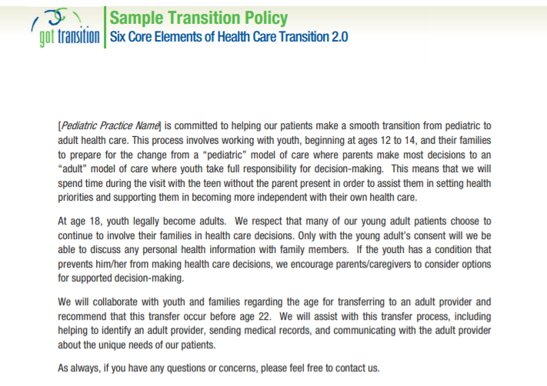
Sample Transition Policy
Notes:
Source Credit: Got Transition Resource Listing
https://www.gottransition.org/resourceGet.cfm?id=221

Slide 13
Transition Tracking
A practice – specific process for identifying and monitoring youth
Standardized tools can streamline the process
Notes:
Transition tracking starts with identification. You can use electronic medical records to “flag” patients of transition age (12 years and older) and to help you keep track of their individual transition plans, readiness assessments, goals, and other transition materials. Checklists (like the one on the next slide) can help you keep track of what you’re tracking!

Slide 14
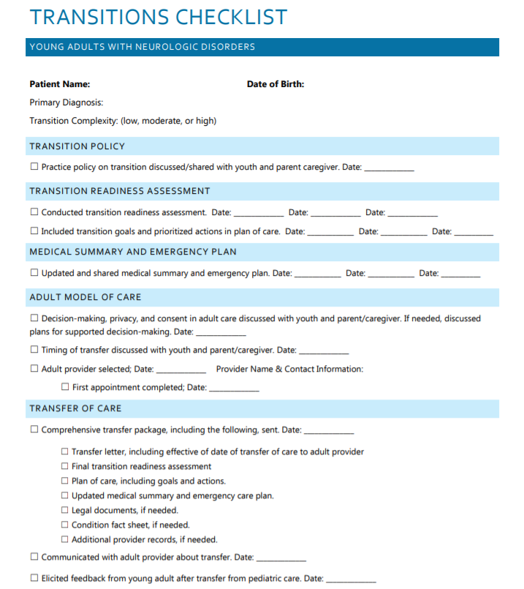
Sample Worksheet
Notes:
Source Credit: Child Neurology Foundation
http://www.childneurologyfoundation.org/wp-content/uploads/2017/08/B_TransitionChecklist.pdf

Slide 15
Readiness Assessments
Help identify patient needs and clarify goals
Assessments should be done annually
Standardized tools are available
All have separate versions for patients and parents / caregivers
Notes:
Transition readiness assessments help providers identify patient needs and help clarify goals for transitioning. Standardized questionnaires ask patients and their parents / caregivers about common adult healthcare issues. Common questions include those about self care, managing activities of daily living (for example, feeding, hygiene, taking / managing medications, etc.), keeping and making appointments, talking with healthcare providers, and monitoring health issues. There are several validated questionnaires, most of which are available in both patient and parent / caregiver versions. Many are available in multiple languages and are designed for patients with lower health literacy. Some are self-assessments and others are designed to be administered by providers. I’ve included an example of a self-assessment for pediatric patients that I commonly use, the UNC STARx Transition Readiness Questionnaire, on the next slide.
The patient should be assessed annually starting at age 14. It often helps to assess both the patient and their parents / caregivers (at least initially). This is very useful for patients with intellectual disability and for those patients who will be responsible for managing their care on their own (i.e., patients who plan to move out of the house, who go away to college, or who prefer to be totally independent for any other reason.) Differences between the patient and parent / caregiver report can help you identify problems and help you start conversations about setting goals. Parents should be assessed on their own if patients have intellectual disability and require very substantial support, if they are medically fragile, if they are are non-speaking / non-verbal, or if they need guardianship.
I have included links to several commonly used readiness assessments in the resource listing at the end of this presentation. One has been designed specifically for patients with intellectual and developmental disabilities: the American College of Physicians’ Transition Readiness Assessment for Youth with Intellectual Disabilities or Developmental Disabilities. Other readiness assessments have been (or are being) validated for use in this population.

Slide 16
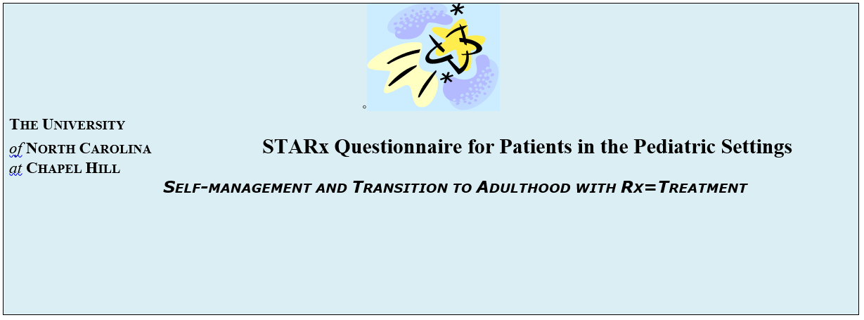
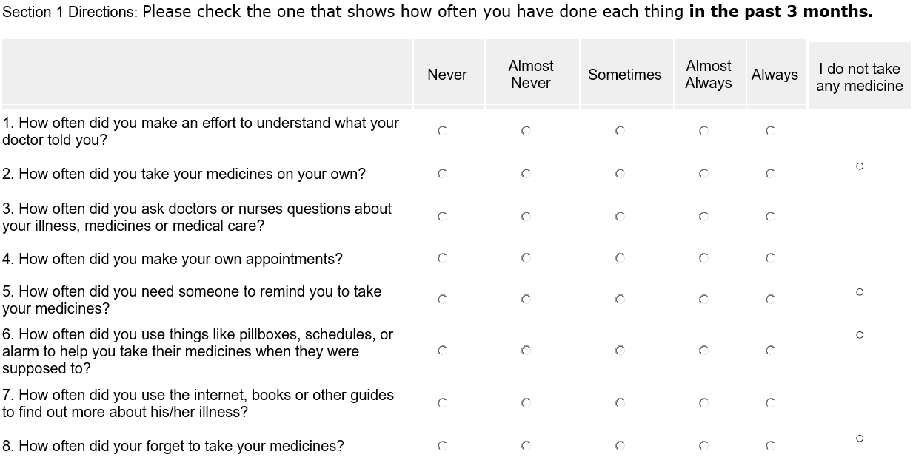
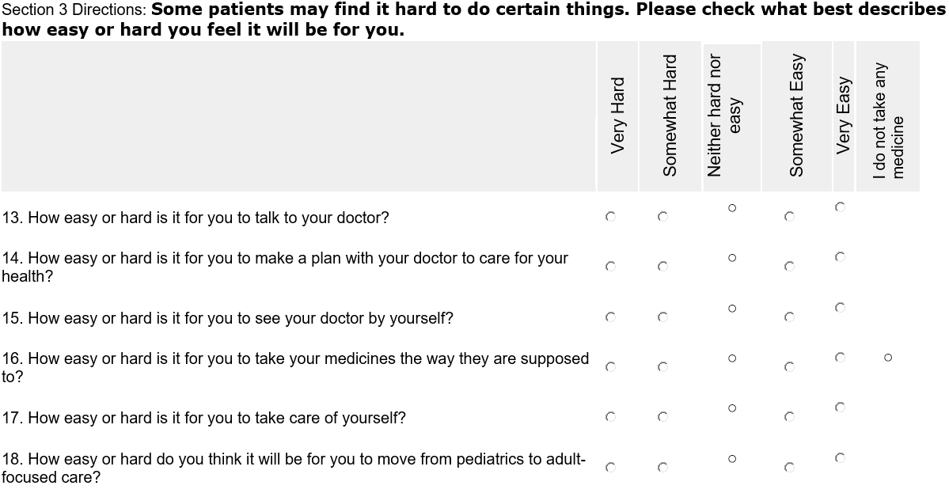
Sample Readiness Assessment
Notes:
Source Credit: UNC STARx Transition Program
https://www.med.unc.edu/transition/transition-tools/trxansition-scale/

Slide 17
Making a Transition Plan
Goals of planning:
To prepare the youth to manage their own care
To empower youth to function independently in the adult healthcare system
To identify appropriate adult healthcare providers
To communicate with accepting providers
Notes:
Developing a patient’s individual transition plan is one of the most important parts of the entire process. The goals of the transition plan are listed above. The plan itself has several components which we’ll talk about in the next few slides.

Slide 18
Plan Components
Comprehensive Medical Summary
Patient’s Understanding of their Diagnosis
Patient’s Self-Management Skills
Readiness Assessments
Patient / Family Preferences and Goals of Care
Transition Timeline
Labs, Imaging, and Other Interventions to be Done Prior to Transfer
Emergency Plans / Action Plans
Advanced Care Plans
Information about Guardianship / Medical Decision-Making
Notes:
The transition plan should include all of the following:
A detailed summary of all of the patient’s medical, surgical, and psychiatric conditions
Descriptions of both the patient’s understanding of their condition and their self-management skills. Providers should be sure to include information about the patient’s understanding of their prognosis and of the effect that their condition has on their reproductive health. This information is especially critical information for patients with intellectual disabilities who will be managing their care on their own
Results of transition readiness assessments
Patient / family preferences for adult services (including preferred hospitals and providers if they have been identified) and goals of care
The planned timing of the transition
Labs, imaging, evaluations, referrals, and any other interventions that will be done before transfer
Emergency plans
Advanced care plans
Information about guardianship if applicable

Slide 19
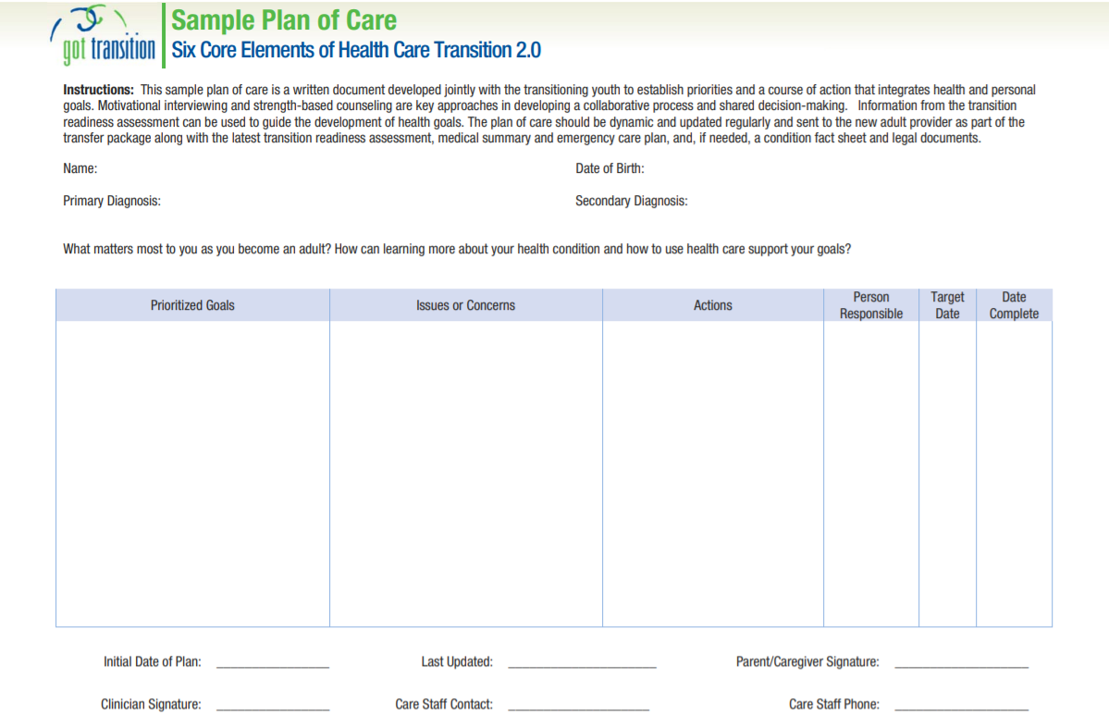
Sample Transition Plan
Notes:
Source Credit: Got Transition
https://www.gottransition.org/resourceGet.cfm?id=226

Slide 20
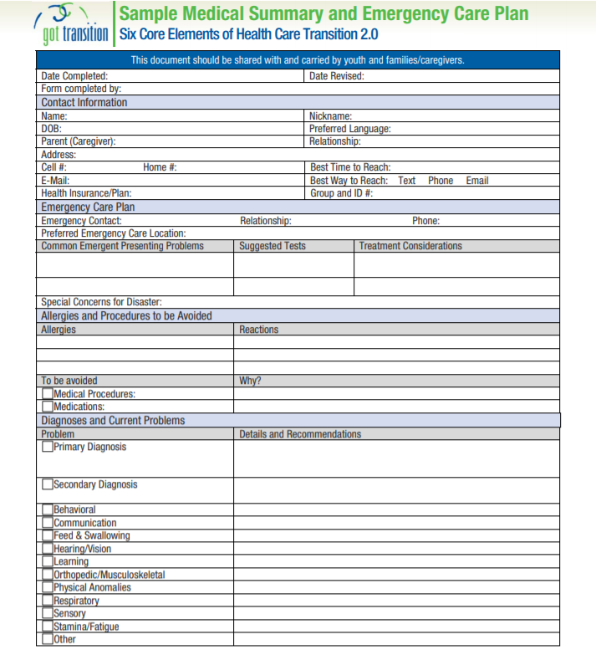
Sample Summary
Notes:
Source Credit: Got Transition
https://www.gottransition.org/resourceGet.cfm?id=227

Slide 21
What Should You Talk About?
The Youth’s Medical Condition(s)
Current Medications, Treatment Plans, and Side Effects
Troubling Symptoms
Mental Health and Wellness
Notes:
A lot of information goes into the transition plan. That means that you, your patient, and their parents / caregivers have a lot to discuss. You should plan to start with the patient’s medical condition. You should find out what they understand about their health, their overall prognosis, and how their medical condition(s) will affect their health in the future. Also be sure to discuss their current treatment plan (and what they know about it) and how this may change as they age. Always reinforce their knowledge about troubling signs and symptoms (especially those that need urgent / emergent care). And always check in with both patients and parents / caregivers about their mental health. This can be a very stressful time for both of them.
The planning visit is very important! There is a lot to cover in the initial visit so you may want to allot extra time. You may need to have a visit that’s separate from your patient’s regular follow up appointments. If you are wondering about billing and coding for these kinds of appointment, you can find additional information in the American Academy of Pediatrics’ “2018 Coding and Reimbursement Tip Sheet for Transition from Pediatric to Adult Health Care.” I’ve included a link at the end of this presentation.

Slide 22
Talking Topics, Continued
Puberty
Sexuality and Reproductive Issues
Genetic Counseling
Notes:
Sexual growth and development are part of normal adolescent development. Adolescents need comprehensive, developmentally appropriate education about puberty, sexuality, and healthy relationship to make informed, healthy decisions. Youth with special healthcare needs, especially those with intellectual and developmental disabilities, are at an extremely high risk for receiving insufficient education about these topics. This knowledge gap puts them at greater risk of negative sexual health outcomes – such as sexually transmitted infections and unwanted or mistimed pregnancies – and also leaves them even more vulnerable to abuse and exploitation. Including this information in discussions about transition planning is of the utmost importance. Primary care providers may decide to talk about puberty and sexuality in general terms. Specialty providers can reinforce this information and provide condition specific information as well (for example, a neurologist should plan to discuss the importance of using contraceptives with a patient who is taking certain anti-seizure medications.)
In addition to talking about reproductive health, providers should make sure to discuss the utility of genetic counseling with patients and parents / caregivers. You may already have had this discussion with patients with neurogenetic conditions. Make sure to revisit the topic when patients get older as well, especially if they are or plan to be sexually active or if they plan to have children themselves.
I’ve included several resources on sexual education for people with autism spectrum disorders, intellectual disability, and other neurodevelopmental disabilities at the end of this presentation.

Slide 23
Talking Topics, Continued
Substance Use
Driving
Employment
School
Housing
Medical Decision-Making
Notes:
Other important adolescent health topics of conversation include avoiding risky behaviors (alcohol and substance use,) driving, employment, and school.
Educational transitioning often occurs at the same time as healthcare transitioning. Many patients with intellectual and developmental disabilities have some kind of special accommodations in school: either an Individualized Education Plan (IEP) or 504 Plan.
Some (brief) background information on IEPs and 504 plans:
The Individuals with Disabilities Education Act (IDEA) guarantees a “free appropriate public education” to children with disabilities that “emphasizes special education and related services designed to meet their unique needs and prepare them for further education, employment, and independent living.”
504 plans are documents that outline the “reasonable accommodations” that are provided to children with disabilities to give them equal opportunity to participate in programs offered to people without disabilities. For example, a child with ADHD and otherwise typical development may need a 504 plan to allow them to sit at the front of the classroom (where they will be less distracted.)
IEPs document a child’s special education requirements. For example, a child with autism spectrum disorder with intellectual disability would need an IEP to describe their specific educational needs, school-based therapy services, behavioral plan, and other issues.
You should inquire about your patient’s plans for their last few years in high school. Students are eligible to receive special education services until they are 22 years old. Some patients who are receiving these services may choose to stay in school until then while others may graduate or receive a certificate at an earlier age. Some patients may plan to go into college or a pre-college program at a local community college. You can then incorporate student health (and disability services at their college / university) into your transition planning.
Other patients may plan to join the workforce. Several disability organizations – like the Arc of North Carolina and the Autism Society of North Carolina – and the North Carolina Department of Health and Human Services have supported employment and job placement programs. I’ve included a few links on the resource listing at the end of this presentation.
Patients may live in one of a variety of living environments during their young adulthood. Inquiring about the patient’s future plans for housing can give you some insight about how responsible they’ll need to be for managing their own healthcare.
It is very important to find out about your patient’s plans for medical decision-making. Some patients with neurodevelopmental and intellectual disabilities may be completely independent as young adults and may be able to make decisions about their health care on their own. Others may need a bit of support. It’s important to know who will be responsible for decision-making for practical purposes. You should plan to convey this information to adult providers as well.
Parents / caregivers often talk about guardianship and may ask you about it. We’ll talk about that on the next slide.

Slide 24
Guardianship
A legal relationship where one individual is given the authority to make decisions on behalf of another individual who is no longer able to make / communicate decisions on their own
Not every person with ID needs guardianship!

Slide 25
Types of Guardianship
Person
Estate
General
Limited
Interim
Notes:
There are five types of guardianship…
Person – help make decisions about care and custody
Estate – help make decisions about property and business affairs
General – covers the individual and their estate
Limited – only applied in areas where an individual needs help
Interim - temporary
Your patient may only need certain kinds of support (or may only need it temporarily.) If it’s needed, guardianship should be tailored to fit an individual’s specific needs.

Slide 26
Guardianship Alternatives
Informal Support
Supported Decision-Making
Foster Care 18-21
Special Bank Accounts
Living Trusts
Special Needs Trusts
Representative Payees
Power of Attorney
Healthcare Power of Attorney
Advance Directives
Living Wills
Notes:
I won’t spend time in this lecture going into the fine points of guardianship and its alternatives. I just wanted to present this list so that you know that there are many options out there (and your patients may come to you for advice about them!) I sourced this list from the “Rethinking Guardianship” Program. You can find additional information at their website. The link is in the resource guide at the end of this presentation.

Slide 27
Things to remember
Patients with ID should not be excluded from transition planning!
Their goals and ideas should be included in the plan
Many patients with ID can develop health-management skills

Slide 28
Adolescent Visits
Adolescents should spend one-on-one time with their provider
Encourages them to take responsibility
Allows them to talk about sensitive topics
Allows providers to find out about goals
Notes:
Remember to spend some one on one time with your adolescent patients who are speaking / communicative.

Slide 29
The Transfer
Eventually, it will be time to transfer!
Gather documents and send them to the new provider
The transfer is not the end of transition!
Patients need close monitoring as they adapt
Notes:
A patient’s transfer package includes their medical summary, care plan (and emergency plan), final transition readiness assessment, condition fact sheet or resources (for patients with rare conditions), and legal documentation if needed. A transfer letter should also be sent along with the package.
You should notify your patient and their parents / caregivers that you will continue to be their provider (and responsible for their care) until they are seen in the adult provider’s clinic.

Slide 30
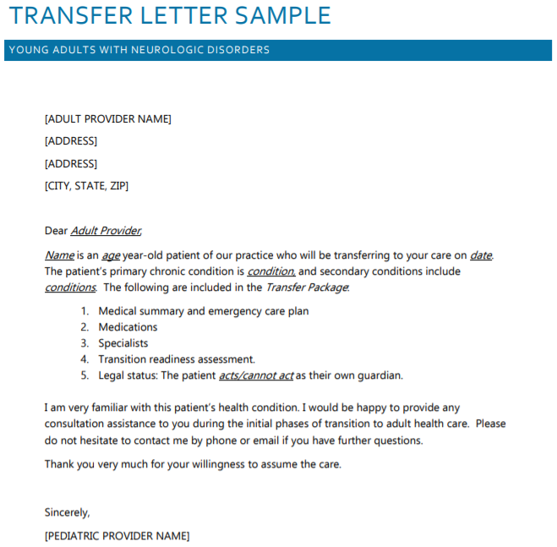
Sample Letter
Notes:
Source Credit: Child Neurology Foundation
http://www.childneurologyfoundation.org/wp-content/uploads/2017/08/E1_TransferLetterSample.pdf

Slide 31
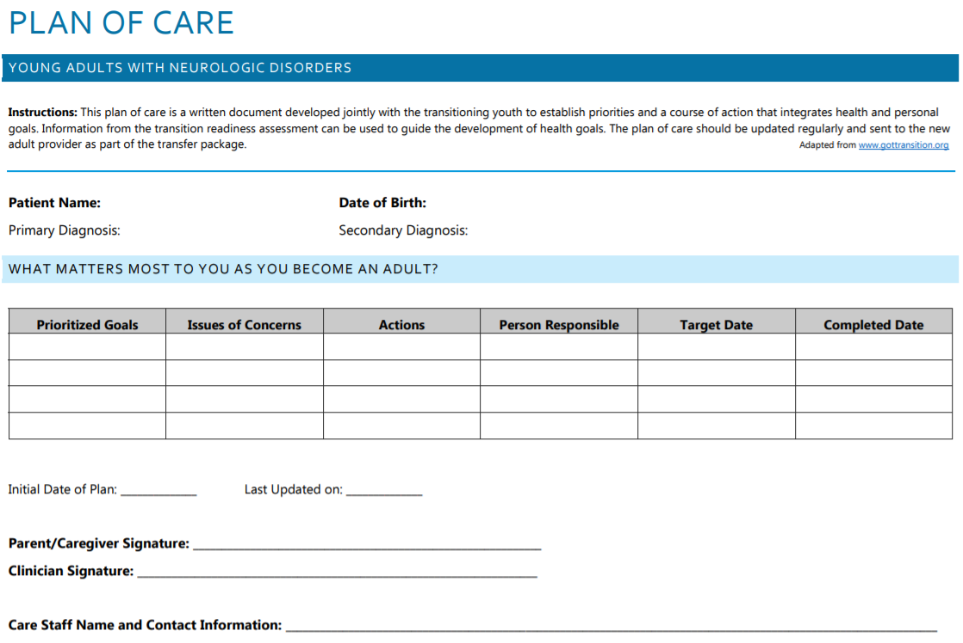
Sample Care Plan
Notes:
Source Credit: Child Neurology Foundation
http://www.childneurologyfoundation.org/wp-content/uploads/2017/08/E2_PlanofCare.pdf

Slide 32
What If You Can’t Find an Adult Provider?
Continue to search for an adult provider
Pediatrics continues to care for the patient
Specialty providers may continue on as a consultant
Notes:
In some cases, you won’t be able to readily identify an appropriate adult provider. This often happens when patients have rare neurological, metabolic, or genetic disorders, certain neurodevelopmental conditions, or complex neurobehavioral disorders or if the patient lives in an area with limited access to care. If this happens, the pediatric provider may decide to continue to treat the patient through adulthood (in which case the patient can still be transitioned to an adult model of care within a pediatric practice.) Providers must continue to help patients search for an adult provider until one can be identified.

Slide 33
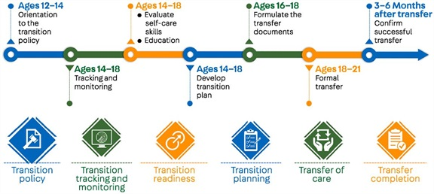
The Transition Process
Notes:
This provides a nice picture of the transition timeline. We’ll talk more about things to do at each step on the pathway in the next few slides.
Image Credit:

Slide 34
More Things to Remember
Talk about transition early and yearly!
Allow youth to start assuming some responsibility early
Start planning early!
Notes:
Before we start, here are a few things to remember.
Encourage parents / caregivers to allow patients to start assuming responsibility for some aspects of their care early on. This can start with something simple, like learning how to list and describe their medications and filling their pill boxes (with supervision) and progress to things like calling in prescription refills, picking them up from the pharmacy, taking medications on their own (after it has been established that they can do this with decreasing supervision), calling their healthcare providers, and making appointments.

Slide 35
First Steps: Age 12 – 13
Provider To Do List:
Start talking about transition
Provide a copy of the transition policy
Start developing the transition plan
Revise emergency / action plans
Patient’s / Parent’s To Do List:
Start talking about transition
Start letting the patient be responsible for 1 easy healthcare task
Start making goals of care
Start thinking about other aspects of transitioning to adulthood
Notes:
Start talking about transition early! Your first discussions should start around 12 years old (or earlier if the parents / caregivers inquire about it.)

Slide 36
Talking Topics at 12 – 13
Transition Process
Why Transition is Important
Adolescent Exam
Youth’s Health (and What They Know About It)
Self-Advocacy Skills
Getting Ready for High School
Special Education Issues
Puberty

Slide 37
To Do at 14
Provider
Ask about guardianship
Ask about post-high school plans
Review and revise the transition plan
Give first readiness assessments
Update emergency plans
Patient / Parents
Look into guardianship and alternatives
Ask for psychological testing
Get ready for driving early
Allow the patient to take on more responsibilities
Start thinking about their new roles

Slide 38
Talking topics at 14
Puberty
Healthy Relationships
Legal Issues and Guardianship
Life After High School

Slide 39
To Do at 15 – 17
Providers
Identify an appropriate adult provider
Review and revise the transition plan
Repeat readiness assessments
Update emergency plans
Develop the transition packet
Start coordinating the transfer
Patient / Parent
Look into adult providers
Gather the patient’s health records
Continue working on post-high school plans
Allow the patient to take on more responsibility

Slide 40
Talking topics at 15 – 17
Healthy Relationships
Legal Issues
Guardianship
Life After High School
Emergency plans
Advanced directives / medical power of attorney / living wills

Slide 41
Ages 18 and Up
Transitioning starts
Providers communicate before and after transfer
The youth may want a final visit with their pediatric provider

Slide 42
Case Study
Emmie is a 13 year old girl with tuberous sclerosis, drug-resistant epilepsy, and autism spectrum disorder with intellectual disability
Emmie’s healthcare providers: primary care, neurologist, psychiatrist, psychologist, OT, SLP
First visit
Practice transition policy reviewed
Overview of the transition process discussed
Transition team leader identified
Seizure action plan / emergency plan updated
Notes:
The following case is an adaptation of one that was presented in “Transition From Pediatric to Adult Neurologic Care.” You can find that article listed on the reference slide at the end of this presentation.
Emmie is a 13 year old girl with tuberous sclerosis, drug-resistant epilepsy, and autism spectrum disorder with intellectual disability who comes to your office with her mother to talk about transition planning. Emmie requires support at home and at school. She is able tocomplete some of her activities of daily living on her own but largely depends on her mother’s care. Mom is planning to apply for some kind of guardianship and will be starting that process when Emmie is a bit older. Emmie’s IEP meeting was last month and a big focus of that meeting was to talk about her transition to high school (and what happens after high school). Mom and Dad are now thinking about keeping Emmie in high school until she turns 22. With this in mind, they scheduled today’s appointment.
You and Mom discuss the transition process and you explain why it is important to make a comprehensive plan for Emmie. You also find out more about what Emmie knows about her own healthcare and try to find out if she is involved in any of her self management skills. Emmie tells you that she gathers her pill cases in the morning and at night and brings them to Mom so that she can take her medications. You suggest that Emmie start learning the names of her medications and, eventually learn how to fill her pill cases with Mom’s help. You take the opportunity to discuss Emmie’s past medications, current medication plan, and side effects. You also talk about how puberty will affect her treatment plan. Mom tells you that Emmie just started her menstrual cycle so you provide some anticipatory guidance about that, hygiene, and how to address Emmie’s newfound curiosity about her body and relationships. You discuss several other topics over the course of this visit.
Mom decided that she would like Emmie’s healthcare transition to start after guardianship is established. You and Mom decide to plan to transfer her care when she is between 19 and 22 years of age. You will be serving as Emmie’s transition team leader. At the end of the visit, you tell Mom to contact Emmie’s other healthcare providers to start conversations about healthcare transition. You send Mom and Emmie home with resources on transition, puberty and adolescent development, an updated emergency plan, and your practice’s transition policy.

Slide 43
Emmie’s Transition
Age 13 – 14 = initial plan made
Transition and emergency plans reviewed yearly
Readiness assessments done yearly
Age 15 – 16 = other planning
Post-high school planning at school
Guardianship process started
Notes:
You, Mom, and Emmie discussed transition issues at every visit. You gave Mom and Emmie transition readiness assessment when Emmie was 14 and identified that they still needed a lot of information about health insurance and reproductive health. You had your social worker reach out to Mom about her insurance questions. You also referred Mom and Emmie to participate in a social skills group for adolescents with autism spectrum disorders and the “Let’s Talk About Sexuality” group at the Carolina Institute for Developmental Disabilities (more information about these groups can be found at http://socialskills.cidd.unc.edu/SocialSkillsGroupClinic/).
You updated Emmie’s transition plan and reassessed their readiness every year. You also made sure to keep the emergency plans up to date. You communicated with Emmie’s other providers as needed.
Between visits, Mom started gathering resources and advice on services for adults with Emmie’s medical conditions. The neurology team provided contact information for community resources, the Tuberous Sclerosis Alliance, and a parent-to-parent support group as the family learned about adult daycare, school/vocational resources, and disability services. When Emmie was 16, Mom met with an attorney to learn more about guardianship and Social Security benefits and then to start the process of obtaining these things.
When Emmie was 17, everyone began to look for appropriate adult providers for Emmie. Luckily, an accepting adult neurologist / epileptologist, nephrologist, and psychiatrist were found within a few months. It took some time to find a psychologist who was a good fit for Emmie. Emmie’s primary care provider is a family practitioner and so Emmie will continue to see them regularly.
You start compiling the transition packet at Emmie’s next visit. Meanwhile, Mom starts gathering her records. Limited guardianship is appointed to Mom. You document this information in the chart. You update Mom and Emmie’s goals of care and assess their knowledge about tuberous sclerosis complex, medications, and seizure care. A copy of the transfer packet was provided to the family, and another was sent to the accepting adult clinician. After this last visit, a member of your team confirmed an appointment was made and attended in the accepting practice.
This case illustrates the complex steps in transitioning a patient with multiple chronic conditions. It also underscores the importance of care coordination and collaboration in a team that includes multiple professionals, such as nurses, social workers, the school, and parent organizations.

Slide 44
Emmie’s Transition
Age 17 = adult providers identified
Age 18 = first transfers begin
Age 19 – 21 = fully integrated into new clinics
Notes:
You, Mom, and Emmie discussed transition issues at every visit. You gave Mom and Emmie transition readiness assessment when Emmie was 14 and identified that they still needed a lot of information about health insurance and reproductive health. You had your social worker reach out to Mom about her insurance questions. You also referred Mom and Emmie to participate in a social skills group for adolescents with autism spectrum disorders and the “Let’s Talk About Sexuality” group at the Carolina Institute for Developmental Disabilities (more information about these groups can be found at http://socialskills.cidd.unc.edu/SocialSkillsGroupClinic/).
You updated Emmie’s transition plan and reassessed their readiness every year. You also made sure to keep the emergency plans up to date. You communicated with Emmie’s other providers as needed.
Between visits, Mom started gathering resources and advice on services for adults with Emmie’s medical conditions. The neurology team provided contact information for community resources, the Tuberous Sclerosis Alliance, and a parent-to-parent support group as the family learned about adult daycare, school/vocational resources, and disability services. When Emmie was 16, Mom met with an attorney to learn more about guardianship and Social Security benefits and then to start the process of obtaining these things.
When Emmie was 17, everyone began to look for appropriate adult providers for Emmie. Luckily, an accepting adult neurologist / epileptologist, nephrologist, and psychiatrist were found within a few months. It took some time to find a psychologist who was a good fit for Emmie. Emmie’s primary care provider is a family practitioner and so Emmie will continue to see them regularly.
You start compiling the transition packet at Emmie’s next visit. Meanwhile, Mom starts gathering her records. Limited guardianship is appointed to Mom. You document this information in the chart. You update Mom and Emmie’s goals of care and assess their knowledge about tuberous sclerosis complex, medications, and seizure care. A copy of the transfer packet was provided to the family, and another was sent to the accepting adult clinician. After this last visit, a member of your team confirmed an appointment was made and attended in the accepting practice.
This case illustrates the complex steps in transitioning a patient with multiple chronic conditions. It also underscores the importance of care coordination and collaboration in a team that includes multiple professionals, such as nurses, social workers, the school, and parent organizations.

Slide 45
Case Study 2
Jack is a 17 year old boy with drug-resistant epilepsy and intellectual disability
Jack’s healthcare providers: primary care, neurologist
Visit
Notification of physician retirement
Referred to adult epilepsy clinic
Seizure action plan updated
Notes:
The following case is an adaptation of one that I saw as a resident.
Jack is a 17 year boy with drug-resistant epilepsy and intellectual disability who goes to see his neurologist for a routine follow up visit. Jack was diagnosed with infantile spasms (a severe epilepsy in infants) when he was around 7 months of age. He subsequently developed Lennox-Gastaut syndrome (a severe epilepsy syndrome in older children) and has been on many different anti-epileptic medications as aa result. Though he continued to have intermittent seizures, his epilepsy was under fairly good control until he was around 13 years of age. At that time, he and his family moved to a different state. He had an episode of status epilepticus (which was thought to be attributable to some missed doses of medication, disrupted sleep, and a viral illness) shortly after the move requiring transfer from his local hospital to a tertiary care center 3 hours away and hospitalization for two weeks. His new epileptologist was able to get Jack’s seizures under control (though he was not as well controlled as he had been prior to that event.) Jack missed appointments occasionally over the next few years due to transportation issues.
Jack has received services at home and at school since infancy. He is able complete very few of his activities of daily living on his own and largely depends on his mother’s care. Mom recently started the process of applying for guardianship.
Jack returned to see his new epileptologist for a routine follow up visit. At that time, his physician informed Jack and his mother that he would be retiring soon and that Jack would need to find a new physician.

Slide 46
Jack’s Transition
Age 17 = Referred to adult epilepsy clinic
Adult clinic 3 hours away
Adult clinic didn’t take Jack’s insurance
Age 18 = Looking for new insurance
Several missed appointments with adult epilepsy
Placed on no-show list
Notes:
Since Jack would be 18 in 2 months, his epileptologist referred him to see an adult epileptologist at an adult tertiary care center.
Jack’s Mom made an appointment with the adult epilepsy clinic but quickly found out that the adult clinic did not take Jack’s insurance. They subsequently missed the first adult clinic visit. Mom applied for new insurance and made a new appointment which they were also unable to keep (because the insurance had not yet kicked in.) By then, Jack was 18 and also unable to come back to the pediatric clinic (and his pediatric epileptologist had since retired.) Jack’s Mom found a local adult neurologist (close to Jack’s home) who had one visit with Jack but who said that he would need to find a specialist to care for him. Mom continued to look for an appropriate epileptologist but Jack eventually started to run low on his medications (and then ran out.) He presented to his local ED at age 20 in status epilepticus. He was subsequently transferred to the adult tertiary care center where he was hospitalized for 3 weeks.

Slide 47
Jack’s Transition
Age 19 = found local neurologist
Neurologist unfamiliar with Jack’s condition
Age 20 = transported to local ED in status epilepticus
Transferred to adult tertiary care hospital
Notes:
Since Jack would be 18 in 2 months, his epileptologist referred him to see an adult epileptologist at an adult tertiary care center.
Jack’s Mom made an appointment with the adult epilepsy clinic but quickly found out that the adult clinic did not take Jack’s insurance. They subsequently missed the first adult clinic visit. Mom applied for new insurance and made a new appointment which they were also unable to keep (because the insurance had not yet kicked in.) By then, Jack was 18 and also unable to come back to the pediatric clinic (and his pediatric epileptologist had since retired.) Jack’s Mom found a local adult neurologist (close to Jack’s home) who had one visit with Jack but who said that he would need to find a specialist to care for him. Mom continued to look for an appropriate epileptologist but Jack eventually started to run low on his medications (and then ran out.) He presented to his local ED at age 20 in status epilepticus. He was subsequently transferred to the adult tertiary care center where he was hospitalized for 3 weeks.

Slide 48
How Could Planning Have Helped?
Identify barriers to accessing care before problems arise
Identify appropriate providers
Help patients make a safety net
Help Mom get started with the guardianship process
Notes:
Jack’s case may seem extreme but it’s something that often happens to patients who have no transition plan in place (and no safety net.) How could things have been different for Jack? Starting the transition conversation early is key here. Early identification of problems (Jack’s transportation and insurance issues especially) and appropriate providers could have helped him avoid this unfortunate outcome.

Slide 49
Last Thoughts
A well organized process can help make things easier for patients, parents / caregivers, and providers
Notes:
I hope that you learned a bit about healthcare transition today and that this presentation helps you counsel your own patients about the process. Additional resources follow this slide. Feel free to contact me with questions!

Slide 50
Questions?

Slide 51
Thank You!

Slide 52
Reference
Acuña Mora M, Moons P, Sparud-Lundin C, Bratt E-L, Goossens E. Assessing the level of evidence on transfer and transition in young people with chronic conditions: protocol of a scoping review. Syst Rev. 2016;5(1):166. doi:10.1186/s13643-016-0344-z.
American Academy of Pediatrics, A. A. of, American Academy of Family Physicians, American College of Physicians, Transitions Clinical Report Authoring Group, Cooley, W. C., & Sagerman, P. J. (2011). Supporting the Health Care Transition From Adolescence to Adulthood in the Medical Home. PEDIATRICS, 128(1), 182–200. https://doi.org/10.1542/peds.2011-0969
American College of Physicians. (2016). HVC Pediatric to Adult Care Transition Intellectual Disabilities/Developmental Disabilities (ID/DD). Retrieved from https://www.acponline.org/system/files/documents/clinical_information/high_value_care/clinician_resources/pediatric_adult_care_transitions/gim_dd/idd_transitions_tools.pdf
Brown, L. W., Camfield, P., Capers, M., Cascino, G., Ciccarelli, M., De Gusmao, C. M., … Zupanc, M. (2016). The neurologist’s role in supporting transition to adult health care. Neurology, 87(8), 835–840. https://doi.org/10.1212/WNL.0000000000002965
Center for Health Care Transition Improvement. (2014). Six Core Elements of Health Care Transition 2.0. Retrieved from www.GotTransition.org
Child Neurology Foundation. Transition of Care. Retrieved October 20, 2018, from http://www.childneurologyfoundation.org/transitions/
Dressler PB, Nguyen TK, Moody EJ, Friedman SL, Pickler L. Use of transition resources by primary care providers for youth with intellectual and developmental disabilities. Intellect Dev Disabil. 2018;56(1):56-68. doi:10.1352/1934-9556-56.1.56.
Hagan JF, Shaw JS, Duncan PM, eds. 2008. Bright Futures: Guidelines for Health Supervision of Infants, Children, and Adolescents. Third Edition. Elk Grove Village, IL: American Academy of Pediatrics.
Oskoui M. Study on the Transition of Adolescents with Neurological Disorders ( STAND ). 2010;(November). http://digitool.library.mcgill.ca/webclient/StreamGate?folder_id=0&dvs=1513635568283~852. Accessed December 18, 2017
Teenagers with mental disability lack reproductive education and knowledge; still, many have had sex. (2003). Perspectives on Sexual and Reproductive Health, 35(4), April 2, 2014.
Tilton, A. H., & De Gusmao, C. M. (2018, February). Transition from Pediatric to Adult Neurologic Care. CONTINUUM Lifelong Learning in Neurology. https://doi.org/10.1212/CON.0000000000000570
Wiegerink, D., Roebroeck, M., Bender, J., Stam, H., & Cohen-Kettenis, P. (2011). Sexuality of young adults with cerebral palsy: Experienced limitations and needs. Sexuality & Disability, 29(2), 119-128. doi:10.1007/s11195-010-9180-6

